Slide 1
M110: Python Programming Meetings #5 Collection Data Types Lists, Tuples
Prepared by Dr. Ahmad Mikati

Slide 2
Contents
Collections
Introduction to lists
List Slicing
Finding items in lists with the in operator
List Methods and useful built-in Functions
Two-dimensional lists
Introduction to Tuples
Tuple Methods and useful built-in Functions
Converting Between Lists and Tuples
Adding Items to a Tuple
Changing Tuple Values

Slide 3
Introduction
Python programming language has four collection data types- list, tuple, sets and dictionary. They have different characteristics based on the declaration and the usage.
A sequence is an object that contains multiple items of data. The items that are in a sequence are stored one after the other.
Python provides various ways to perform operations on the items that are stored in a sequence.
There are several different types of sequence objects in Python.
In this lecture, we will look at two of the fundamental sequence types: lists and tuples.
Both lists and tuples are sequences that can hold various types of data.

Slide 4
Lists
A list is an object that contains multiple data items.
Lists are mutable, which means that their contents can be changed during a program’s execution.
Lists are dynamic data structures, meaning that items may be added to them or removed from them.
You can use indexing, slicing, and various methods to work with lists in a program.

Slide 5
Lists
A list is a data structure in Python that is a mutable (or changeable), ordered sequence of elements.
Each element or value that is inside of a list is called an item.
Lists are defined by having values between square brackets [ ].
Lists are great to use when you want to work with many related values.
They enable you to keep data together that belongs together, condense your code, and perform the same methods and operations on multiple values at once.
To create a list, we use square brackets to indicate the start and end of the list and separate the items by commas.
Here is a statement that creates a list of integers:
List1= [1,2,3,4,5]

Slide 6
Lists
List1= [1,2,3,4,5]
You can use the print function to print the entire contents of a list:
print(List1) #[1, 2, 3,4,5] will be printed
Lists are mutable: individual elements can be reassigned in place.
List1[0] = 6
print(List1) #[6, 2, 3,4,5] will be printed
The empty list is []. It is the list equivalent of 0 or empty string ‘’.
If you have a long list to enter, you can split it across several lines, like below:
nums = [0, 1, 2, 3, 4, 5, 6, 7, 8, 9, 10, 11, 12, 13, 14, 15, 16, 17, 18, 19, 20, 21, 22, 23, 24, 25, 26, 27, 28, 29, 30, 31, 32, 33, 34, 35, 36, 37, 38, 39, 40]

Slide 7
Lists
An example of a list with three integers is [4, 2, -9].
Lists can be assigned to variables, e.g., temperatures= [4, 2,-9]. The variable name should reflect the content of the list to make the program easier to understand.
There are several things which work the same way for lists as for strings.
len(): where you can use len(L) to know the number of items in a list L.
in: operator which tells you if a list contains something.
Examples:
len(temperatures) computes the length of temperatures (3)
if 2 in temperatures:
print('Your list contains number 2.')
if 0 not in temperatures:
print('Your list has no zeroes.')

Slide 8
Lists
Iterating over a List with the for Loop
You can also iterate over a list with the for loop as follows:
1- iterate-by-item
2- iterate-by-position (index)
1- iterate-by-item:
The for loop is used to iterate over the items of any sequence using in operator
2- iterate-by-position:
The for loop is also used to access elements from a sequence via their position using built-in function range().
Example: Both of the following examples print out the items of a list
iterate-by-item
iterate-by-position
L=[6,7,8,9,10]
for i in L:
print(i, end=' ')
L=[6,7,8,9,10]
for i in range(5):
print(L[i], end=' ')
6 7 8 9 10
6 7 8 9 10

Slide 9
Lists
The Repetition Operator
The repetition operator makes multiple copies of a list and joins them all together.
Here is the general format: list * n
In the general format, list is a list, and n is the number of copies to make.
Example:
List1= [1,2,3,4,5]
List2=List1*2
print(List2)
[1, 2, 3, 4, 5, 1, 2, 3, 4, 5]

Slide 10
Lists
Concatenating Lists
To concatenate means to join two things together. You can use the + operator to concatenate two lists.
Example:
list1 = [1, 2, 3, 4]
list2 = [5, 6, 7, 8]
list3 = list1 + list2
print(list3)
[1, 2, 3, 4, 5, 6, 7, 8]
You can also use the += augmented assignment operator to concatenate one list to another.
Example:
list1 = [1, 2, 3, 4]
list2 = [5, 6, 7, 8]
list1 += list2
print(list1)
[1, 2, 3, 4, 5, 6, 7, 8]
N.B: If you try to concatenate a list with something that is not a list, an exception will be raised.

Slide 11
Lists
Indexing and slicing work exactly as with strings: L=[5,7,9, 8,10]
Indexing:To retrieve an element of the list, we use the index operator ([]):
L[0] is the first item of the list L. ➔5
Sometimes, you want to select more than one element from a sequence.
In Python, you can write expressions that select subsections of a sequence, known as slices.
Slicing: A slice is a subset of list elements that are taken from a sequence. When you take a slice from a list, you get a span of elements from within the list.
To get a slice of a list, write the following general format:
list_name[start : stop : step]
The expression returns a list containing a copy of the elements from start up to (but not including) stop. The step is an integer number specifying the step of the slicing.

Slide 12

Lists
Examples:
list1 = [1, 2, 3, 4,5,6,7,8]
print(list1[1:4])
[2, 3, 4]
print(list1[:3])
[1, 2, 3]
print(list1[4:])
[5, 6, 7, 8]
print(list1[1:len(list1)])
[2, 3, 4, 5, 6, 7, 8]
print(list1[::2])
[1, 3, 5, 7]
print(list1[-1:-5:-1])
[8, 7, 6, 5]

Slide 13
List Methods and Built-in Functions
Lists have numerous methods that allow you to add elements, remove elements, change the ordering of elements, and so forth.
Below are some useful methods:
Method | Description
append(item) | Adds item to the end of the list.
index(item) | Returns the index of the first element whose value is equal to item.
insert(index, item) | Inserts item into the list at the specified index. When an item is inserted into a list, the list is expanded in size to accommodate the new item. The item that was previously at the specified index, and all the items after it, are shifted by one position toward the end of the list.
sort() | Sorts the items in the list so they appear in ascending order (from the lowest value to the highest value).
remove(item) | Removes the first occurrence of item from the list.
reverse() | Reverses the order of the items in the list.
count (item) | returns the number of occurrences of item in the list
pop(index) | removes the item at the specified index and returns its value

Slide 14
List Methods and Built-in Functions
Examples:
L1 = [0,3,2]
L1.append(1)
print(L1)
alist=[10,12,15,16,12,13]
alist.remove(12)
print(alist)
[0, 3, 2, 1]
[10, 15, 16, 12, 13]
L1 = [0,3,2]
print(L1.index(3))
1
alist=[10,12,15,16,12,13]
alist.reverse()
print(alist)
[13, 12, 16, 15, 12, 10]
L1 = [0,3,2]
L1.insert(2,4)
print(L1)
[0, 3, 4, 2]
alist=[10,12,15,16,12,13]
print(alist.count(12))
2
L1 = [0,3,2]
L1.sort()
print(L1)
alist=[10,12,15,16,12,13]
alist.pop(2)
print(alist)
[0, 2, 3]
[10, 12, 16, 12, 13]

Slide 15
List Methods and Built-in Functions
There are several built-in functions that operate on lists.
Below are some useful functions
Function | Description
len | Returns the number of items in the list
sum | Returns the sum of the items in the list
min | Returns the minimum of the items in the list
max | Returns the maximum of the items in the list
For example, the following computes the average of the values in the list L:
L=[5,7,9, 8,10]
average= sum(L)/len(L)
print(average)
➔7.8

Slide 16
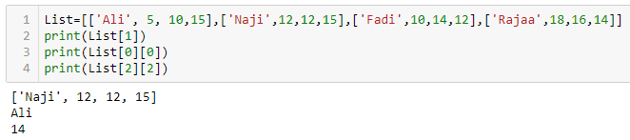
Two-Dimensional Lists (Lists of Lists)
A two-dimensional list is a list that has other lists as its elements.
Lists of lists are also known as nested lists, or two-dimensional lists.
It is common to think of a two-dimensional list as having rows and columns of elements
Example:
List=[['Ali', 5, 10,15],['Naji',12,12,15],['Fadi',10,14,12],['Rajaa',18,16,14]]
List is a list of lists. Each item in this list is a list that is composed of ,say, name and three grades.
List[1] will report ['Naji', 12, 12, 15]
List[0][0] will report Ali
List[2][2] will report 14

Slide 17
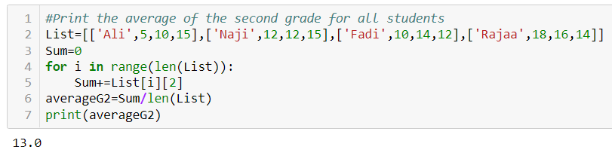
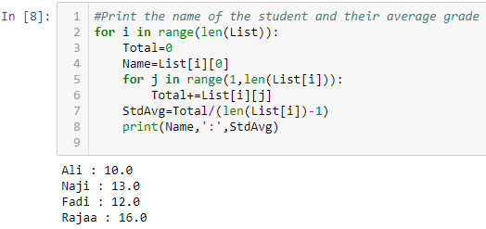
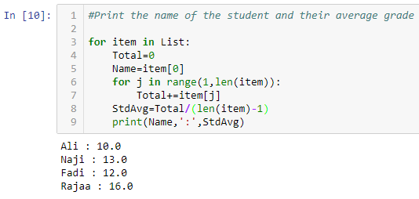
List of lists Example
Suppose we have the following list:
List=[['Ali', 5, 10,15],['Naji',12,12,15],['Fadi',10,14,12],['Rajaa',18,16,14]]
Print the average of the second grade for all students.
This is not the function sum! Why can’t we use the sum function here?
Accessing the 2nd grade
Print the name of the student and his/her average grade
OR

Slide 18
Tuples
A tuple is a sequence, very much like a list. The primary difference between tuples and lists is that tuples are immutable. That means once a tuple is created, it cannot be changed.
When you create a tuple, you enclose its elements in a set of parentheses, as shown in the following example:
my_tuple = (1, 2, 3, 4, 5)
print(my_tuple)
(1, 2, 3, 4, 5)
Initialize a Tuple
There are two ways to initialize an empty tuple.
You can initialize an empty tuple by having () with no values in them.
my_Tuple = ()
You can also initialize an empty tuple by using the tuple function.
my_Tuple = tuple()

Slide 19
Tuples
Iteration by item :
The following example shows how a for loop can iterate by the items in a tuple:
my_tuple = (1, 2, 3, 4, 5)
for item in my_tuple:
print(item, end=' ')
1 2 3 4 5
Iteration by index:
The following example shows how a for loop can iterate by the index in a tuple:
my_tuple = (1, 2, 3, 4, 5)
for i in range(len(my_tuple)):
print(my_tuple[i], end=' ')
1 2 3 4 5

Slide 20
Tuples
Tuples support all the same operations as lists, except those that change the contents of the list.
Tuples support the following:
Subscript indexing (for retrieving element values only)
Methods such as index()
Built-in functions such as len(), min(), and max()
Slicing expressions
The in operator
The + and * operators
Tuples do not support methods such as append(), remove(), insert(), reverse(), and sort().
NOTE: If you want to create a tuple with just one element, you must write a trailing comma after the element’s value, otherwise Python will not recognize it as a tuple.
my_tuple = (1,) # Creates a tuple with one element.

Slide 21
Tuples
You might wonder why tuples exist, if the only difference between lists and tuples is immutability!
One reason that tuples exist is performance- faster than processing a list
Another reason is that tuples are safe- not allowed to change the contents of a tuple
Converting Between Lists and Tuples
You can use the built-in list() function to convert a tuple to a list, and the built-in tuple() function to convert a list to a tuple.
my_tuple = (1, 2, 3, 4, 5)
my_list= list(my_tuple)
print(my_list)
[1, 2, 3, 4, 5]
list1=['Ali', 'Mazen', 'Nawaf']
tuple1= tuple(list1)
print(tuple1)
('Ali', 'Mazen', 'Nawaf')

Slide 22
Tuples
Change Tuple Values
Once a tuple is created, you cannot change its values. Tuples are immutable.
But there is a workaround. You can convert the tuple into a list, change the list, and convert the list back into a tuple.
x = ("apple", "banana", "cherry")
y = list(x)
y[1] = "kiwi"
x = tuple(y)
print(x)
('apple', 'kiwi', 'cherry')

Slide 23
Tuples
Add Items
Since tuples are immutable, they do not have a build-in append() method, but there are other ways to add items to a tuple.
Convert into a list: Just like the workaround for changing a tuple, you can convert it into a list, add your item(s), and convert it back into a tuple.
my_tuple = ("apple", "banana", "cherry")
y = list(my_tuple)
y.append("orange")
my_tuple = tuple(y)
print(my_tuple)
('apple', 'banana', 'cherry', 'orange')
Add tuple to a tuple.
my_tuple = ("apple", "banana", "cherry")
y = ("orange",)
my_tuple += y
print(my_tuple)
('apple', 'banana', 'cherry', 'orange')

Slide 24
Exercise
Given the following list of lists: grades_list = [[1, 2, 3], [4, 5, 6], [7, 8, 9]]. Convert it to a list of tuples.
grades_list = [[1, 2, 3], [4, 5, 6], [7, 8, 9]]
tuples_list=[]
# Convert list of lists to a list of tuples
for item in grades_list:
tuples_list=tuples_list+ [tuple(item)]
print(tuples_list)
or
tuples_list+=[tuple(item)]
[(1, 2, 3), (4, 5, 6), (7, 8, 9)]

Slide 25
Extra Exercises
Find the second largest element in a list of integers
Find the nth largest element in a list of integers
Given a list of integers, find the first number that is divisible by 3
Given a list of strings, count the number of strings that are longer than 5 characters.
Given a list of strings, find the longest string in the list.
Write a program that takes in a list of numbers and finds the largest prime number in the list.
Given a list of tuples, find the average of the second elements of all the tuples.

Slide 26
Summary
This lecture covered:
Lists, including:
Repetition and concatenation operators
Indexing
Techniques for processing lists
Slicing and copying lists
List methods and built-in functions for lists
Two-dimensional lists
Tuples, including:
Immutability
Difference from and advantages over lists

